Slide 1
The Future of AI in Healthcare
Presenter: [Your Name]
Date: [Date]
Affiliation: [Your Organization]

Slide 2
Agenda
Introduction to AI in Healthcare
Current Applications of AI in Healthcare
Future Trends and Potential Impact

Slide 3
03
Introduction to AI in Healthcare

Slide 4
What is Artificial Intelligence (AI)?
What is Artificial Intelligence (AI)?
Artificial Intelligence (AI): Simulation of human intelligence processes by machines.
Key Concepts:
* Machine Learning (ML): Algorithms that learn from data without explicit programming.
* Deep Learning (DL): ML with artificial neural networks to analyze complex data.
* Natural Language Processing (NLP): Enabling computers to understand and process human language.

Slide 5
Why AI in Healthcare?
Addressing Critical Challenges:
* Rising Healthcare Costs: AI
can automate tasks, improve
efficiency, and reduce errors.
* Aging Populations: AI can
assist with remote monitoring,

Slide 6
04
Current Applications of AI in Healthcare

Slide 7

AI in Diagnostics

Slide 8
AI in Drug Discovery and Development

Slide 9
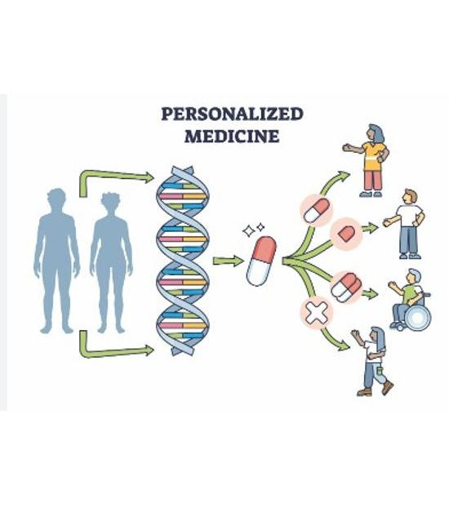
AI in Personalized Medicine

Slide 10
AI in Administrative Tasks & Remote Patient Monitoring
AI in Administrative Tasks & Remote Patient Monitoring
AI in Administrative Tasks:
- Automating billing and coding processes.
- Streamlining appointment scheduling.
- Reducing administrative overhead.
AI in Remote Patient Monitoring:
- Wearable sensors for continuous health monitoring.
- Early detection of health issues through AI algorithms.
- Improved patient outcomes and reduced hospital readmissions.

Slide 11
05
Future Trends and Potential Impact

Slide 12

AI-Powered Robotic Surgery

Slide 13

AI-Driven Virtual Assistants

Slide 14
Predictive Analytics & Mental Healthcare
Predictive Analytics & Mental Healthcare
Predictive analytics for disease outbreaks: Forecasting and managing epidemics and pandemics using AI.
AI in mental healthcare: Accessible and personalized mental health support through chatbots and virtual therapists.
The Metaverse and AI in Healthcare: Immersive technologies for training, therapy, and patient engagement.

Slide 15
06
Challenges and Ethical Considerations

Slide 16
Key Challenges in AI Healthcare
Key Challenges in AI Healthcare
**Data Privacy and Security:** Protecting patient data is paramount.
**Algorithmic Bias and Fairness:** Ensuring equitable outcomes for all.
**Explainability and Transparency:** Understanding AI decision-making.
**Regulatory Frameworks and Governance:** Establishing clear guidelines.
**Human Oversight:** Maintaining human control and accountability.

Slide 17

Ethical AI Development Lifecycle

Slide 18
Key Takeaways: AI in Healthcare
AI improves diagnostics, treatment, and patient care.
Current applications show value in imaging and drug discovery.
Address data privacy, bias, and ethical considerations.

Slide 19
Embracing the Future Responsibly
Foster collaboration and prioritize ethical considerations.
Invest in training to equip healthcare professionals.
Embrace AI responsibly to improve patient outcomes.

Slide 20
Q&A
Open questions. Happy to address any topics.
Contact: [Your Name], [Your Email]
[Your LinkedIn Profile (Optional)]

Slide 21
Q&A - Continued
Thank you for your questions, we'll continue addressing them.
Reach out via email or LinkedIn if we run out of time.
Additional resources are on our website (link in next slide).

